Slide 1
Calibrating boolean models of endocrine differentiation
Sarah Maddox Groves and Christian Meyer

Slide 2
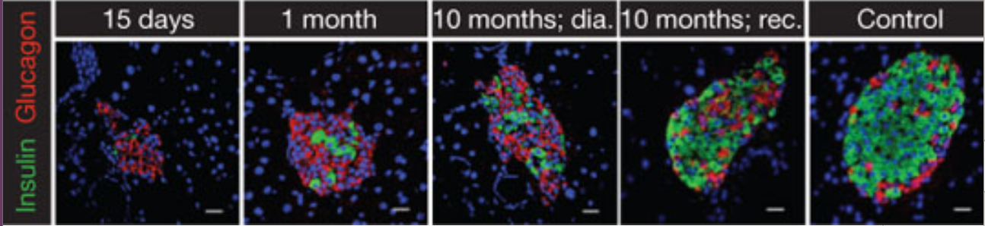
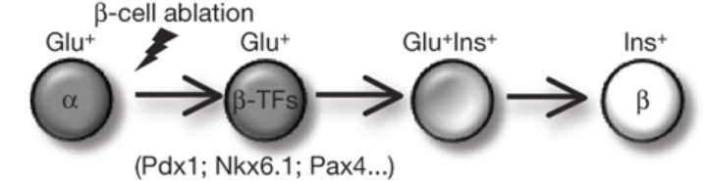
“Regenerative Medicine”....in situ
Alpha to beta cell conversion after total ablation
Thorel et al, Conversion of adult pancreatic α-cells to β-cells after extreme β-cell loss Nature, 2010
Notes:
Beta cell ablation in embryogenesis results in delta cell transdifferentiation
No transdifferentiation occurred in partial ablation

Slide 3
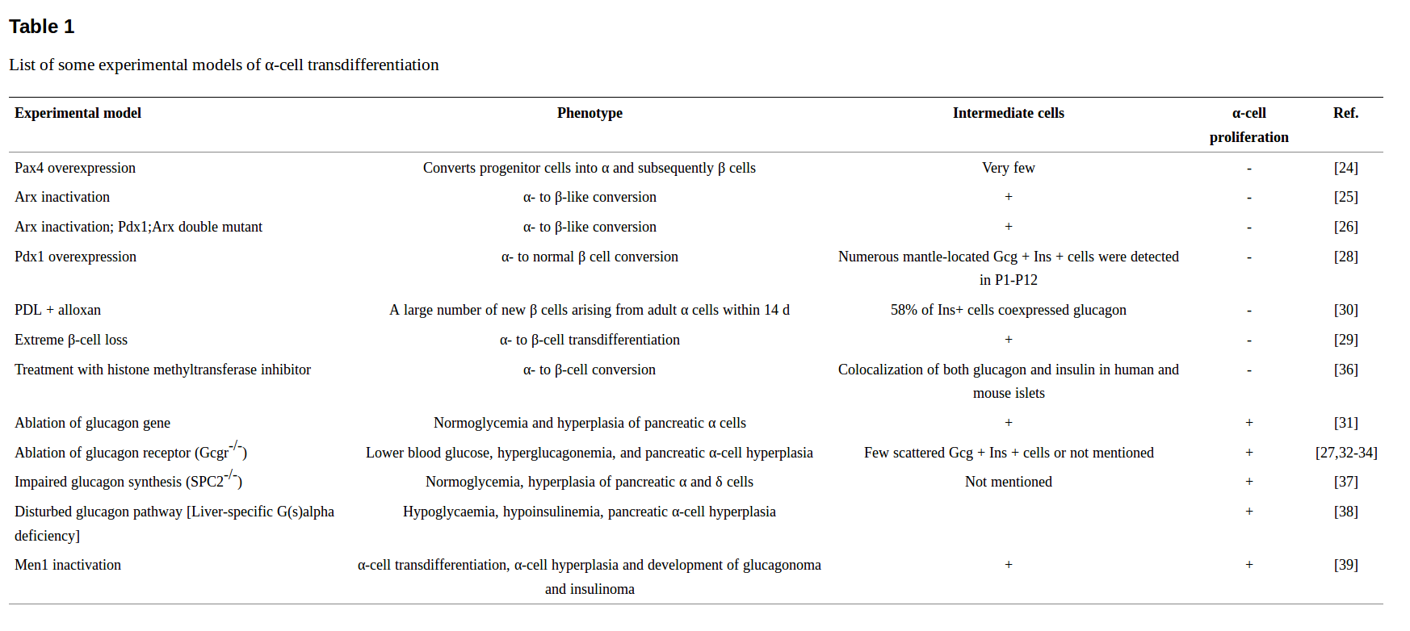
Experimental models of transdifferentiation
Lu et al World J Diabetes (2014)
Notes:
Beta cell ablation in embryogenesis results in delta cell transdifferentiation
No transdifferentiation occurred in partial ablation

Slide 4
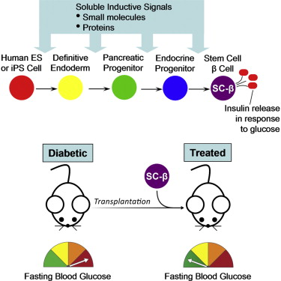
“Regenerative Medicine”....in vitro
Stem cell to Beta cell differentiation in a dish
Pagliuca et al, Generation of Functional Human Pancreatic β Cells In Vitro. Cell, 2014
Notes:
Beta cell ablation in embryogenesis results in delta cell transdifferentiation
No transdifferentiation occurred in partial ablation

Slide 5
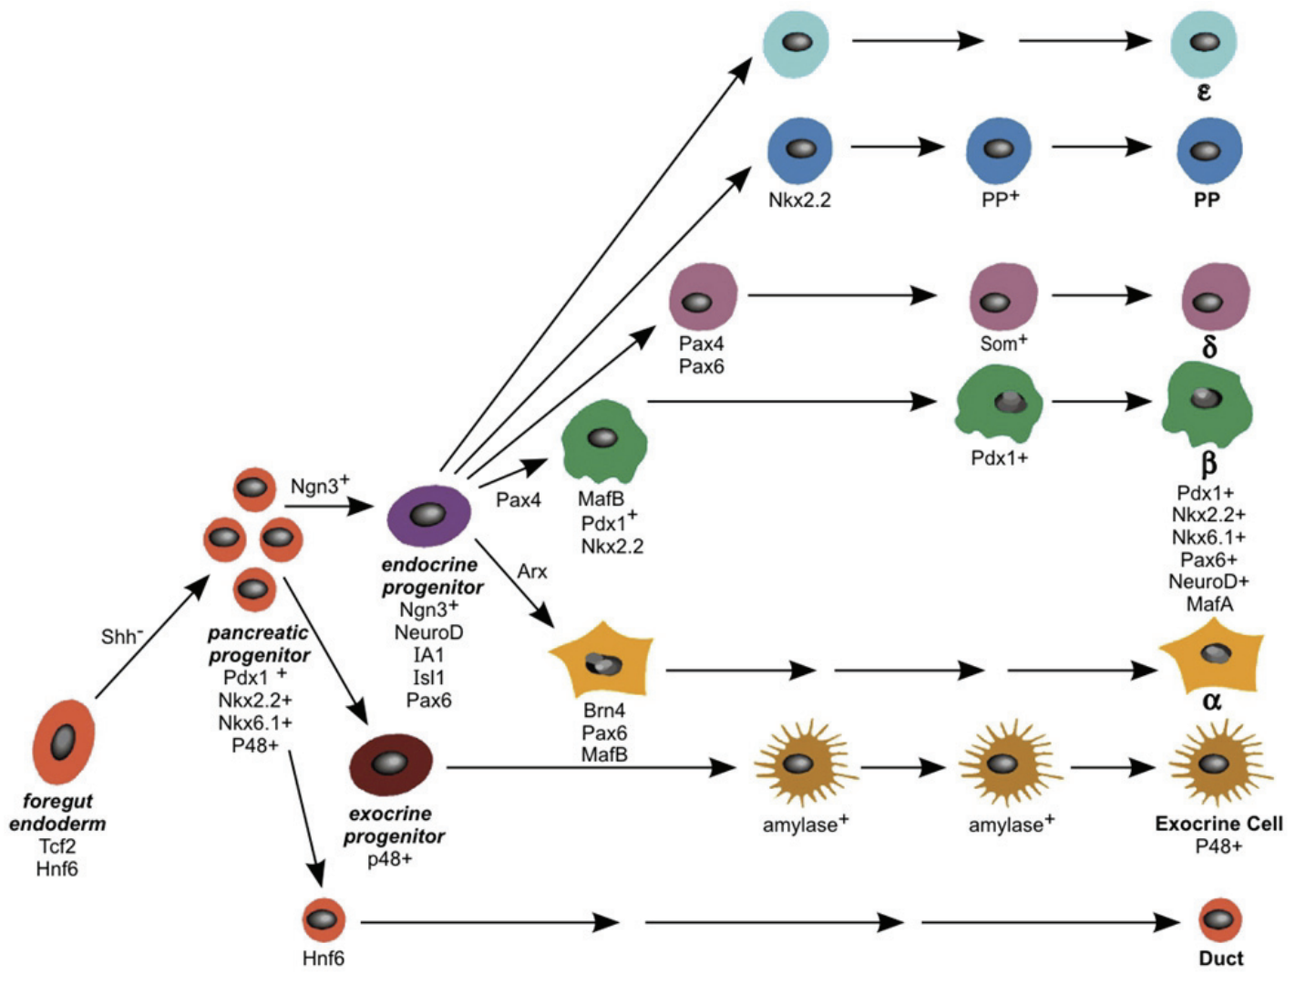
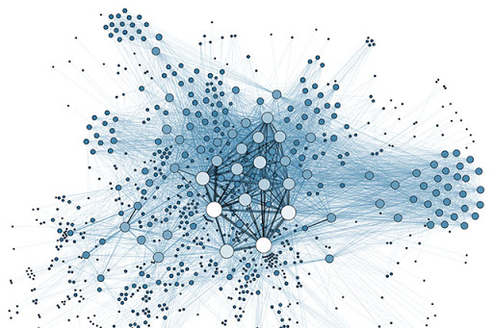
The Goal
Networks --------------------> Experiments
Predict intervention strategies to manipulate cellular identity or differentiation trajectories based on models of transcription factor networks.

Slide 6
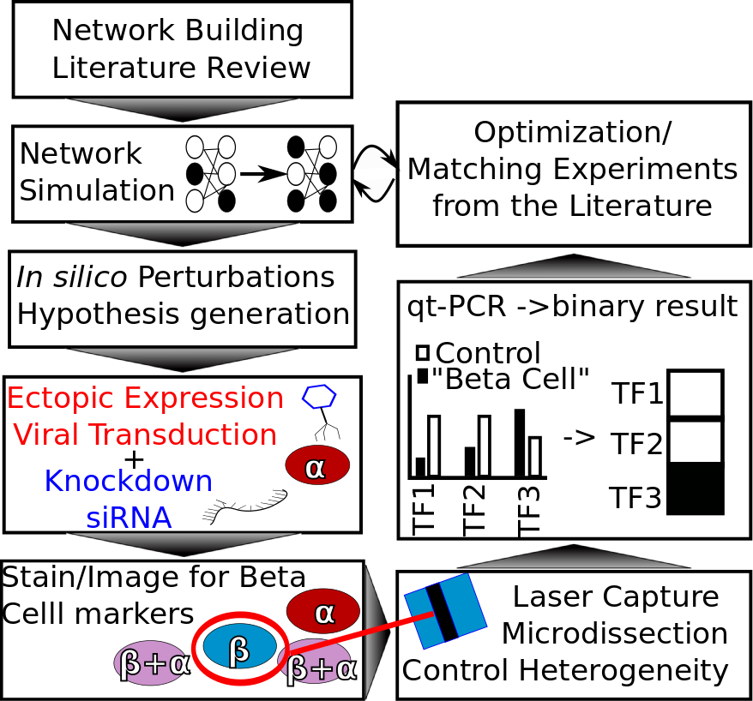
The (Original) Proposed Pipeline

Slide 7

The (Original) Proposed Pipeline
-Christian returning from trip to 2015...

Slide 8
The (Original) Proposed Pipeline
-Christian returning from trip to 2015...

Slide 9
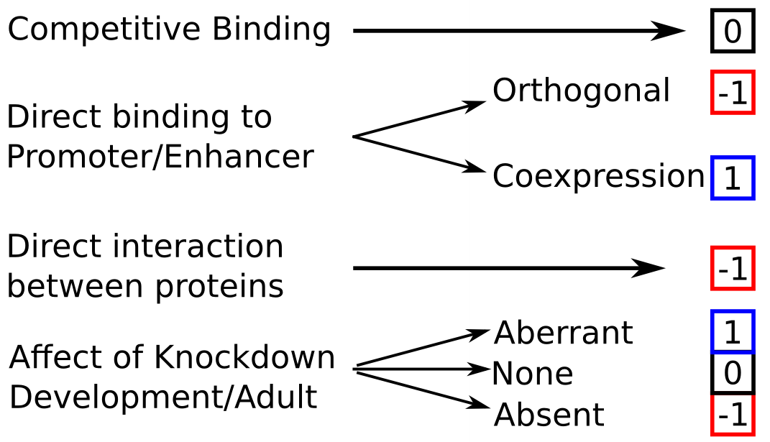
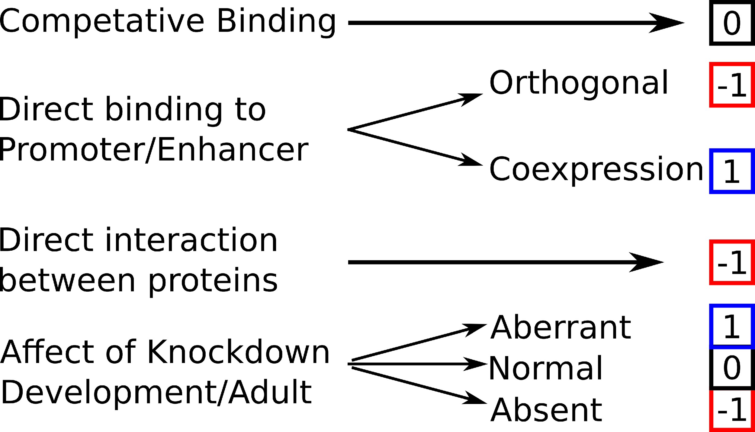
Possible Interactions

Slide 10
Selected Interactions

Slide 11
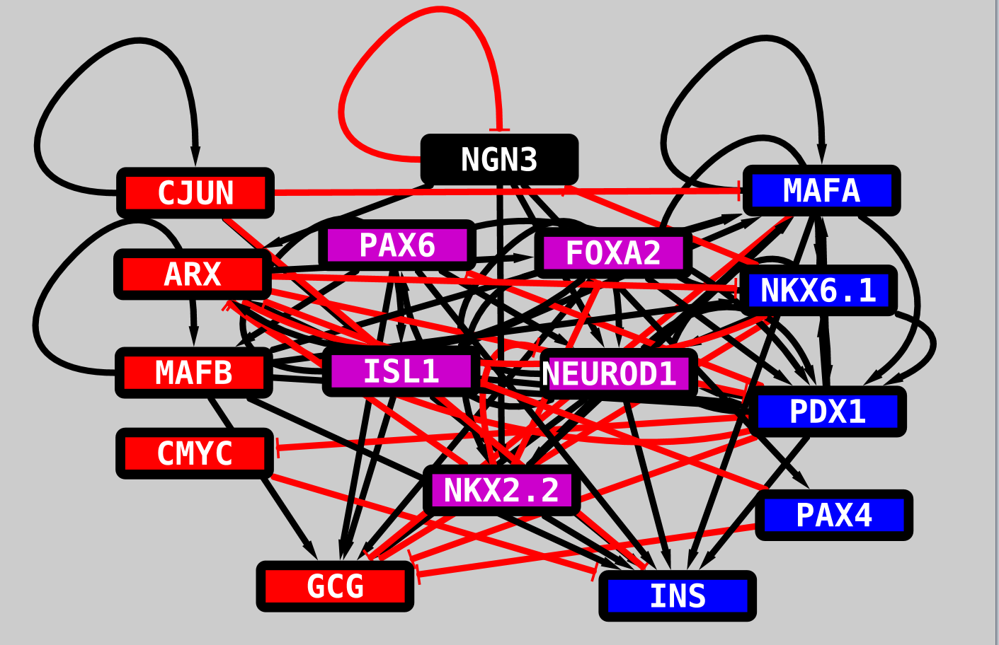


Literature Derive Network V.14
14 TFs
70 Edges

Slide 12
Summary/Conclusions (from Nov. 2015)
Network can be optimized to have attractors which are similar to expected TF profiles.
Literature derived network is statistically significant
Model can generate hypotheses.
Next step is to begin to model a system with data I can verify.
Using in vitro cell lines, perform perturbations and feedback information to model.
Transition away from boolean?

Slide 13











Ideal data
Sample count is not the same thing as informative

Slide 14

Ideal data
Need the transitions to accurately map trajectories

Slide 15
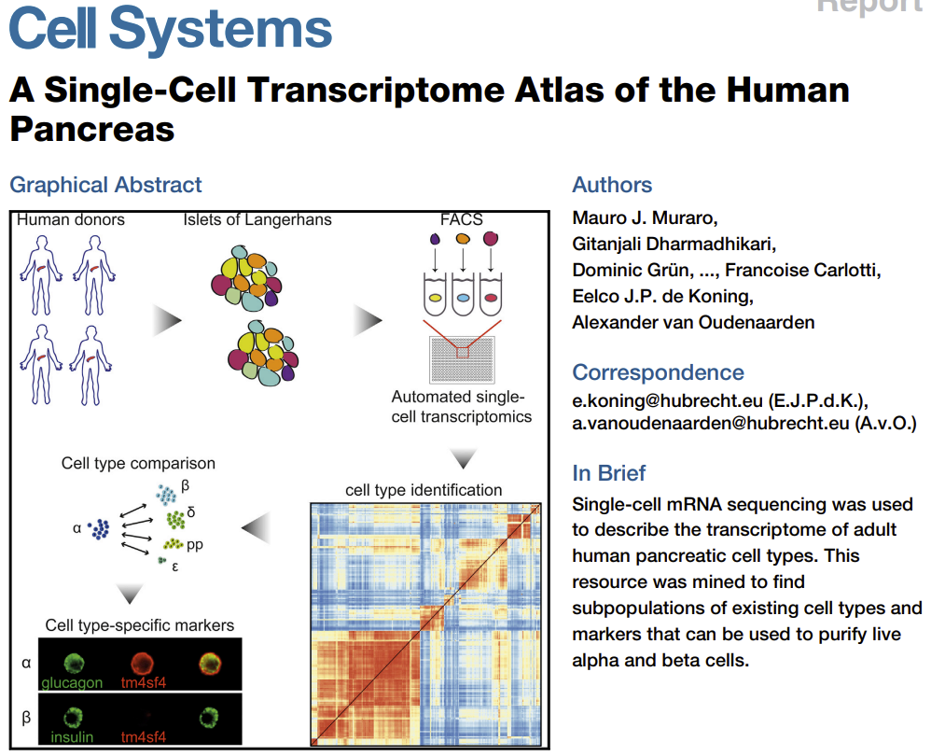
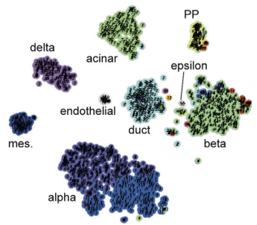
(Not) ideal data
Notes:
pCreode

Slide 16
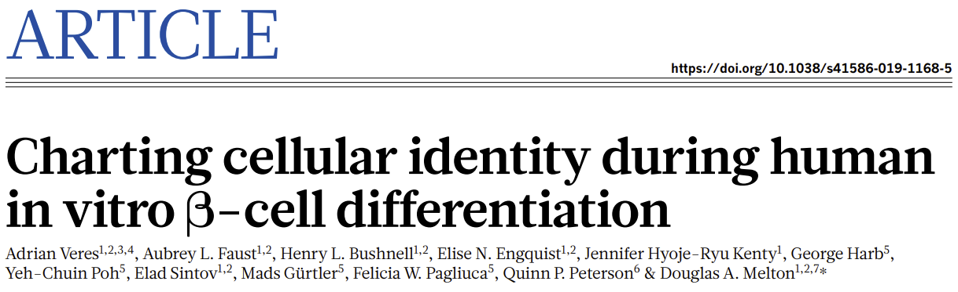
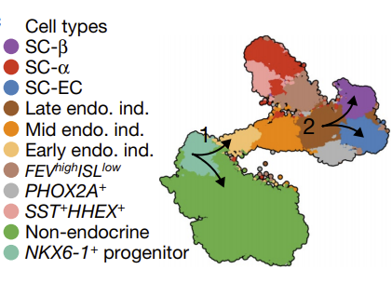
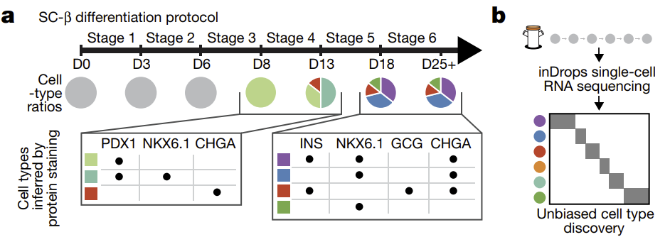
Preliminary Case Study: Melton paper with scRNAseq for in vitro differentiation

Slide 17

“Progress in science depends on new techniques, new discoveries and new ideas, probably in that order. “
Sydney Brenner, 1927-2019

Slide 18
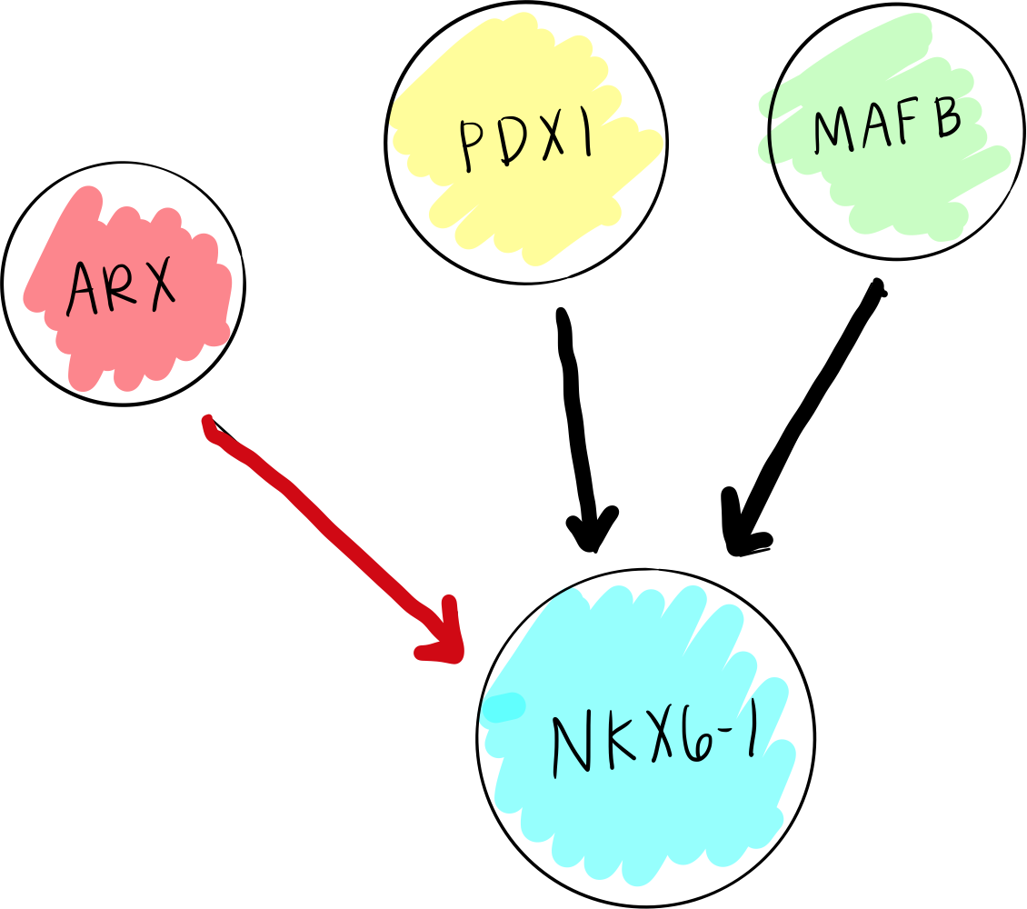
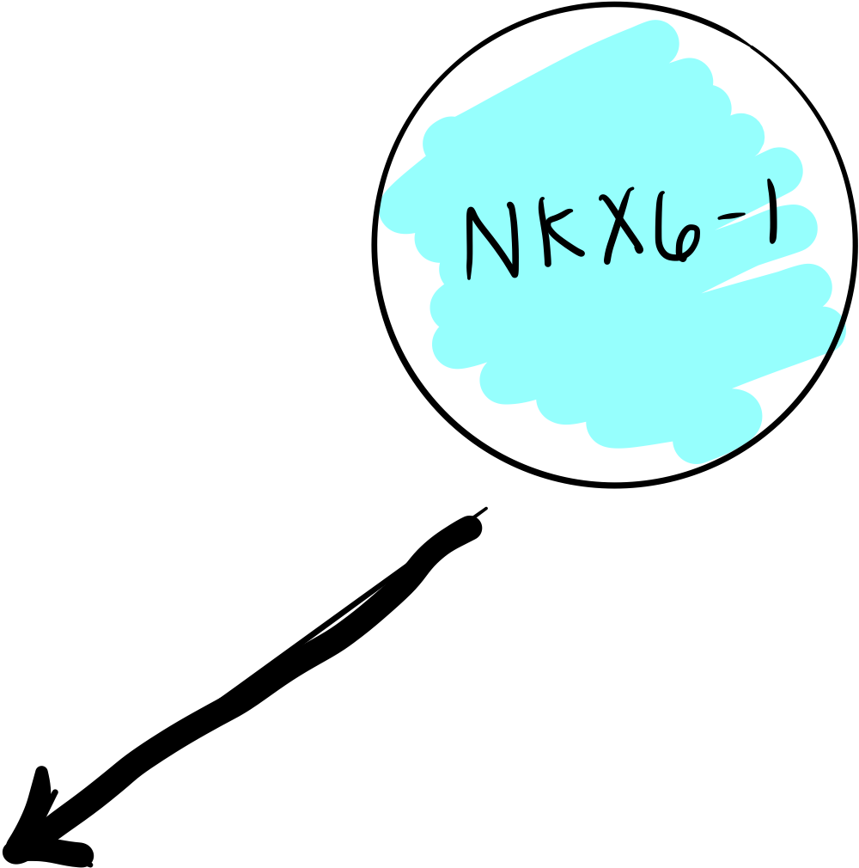
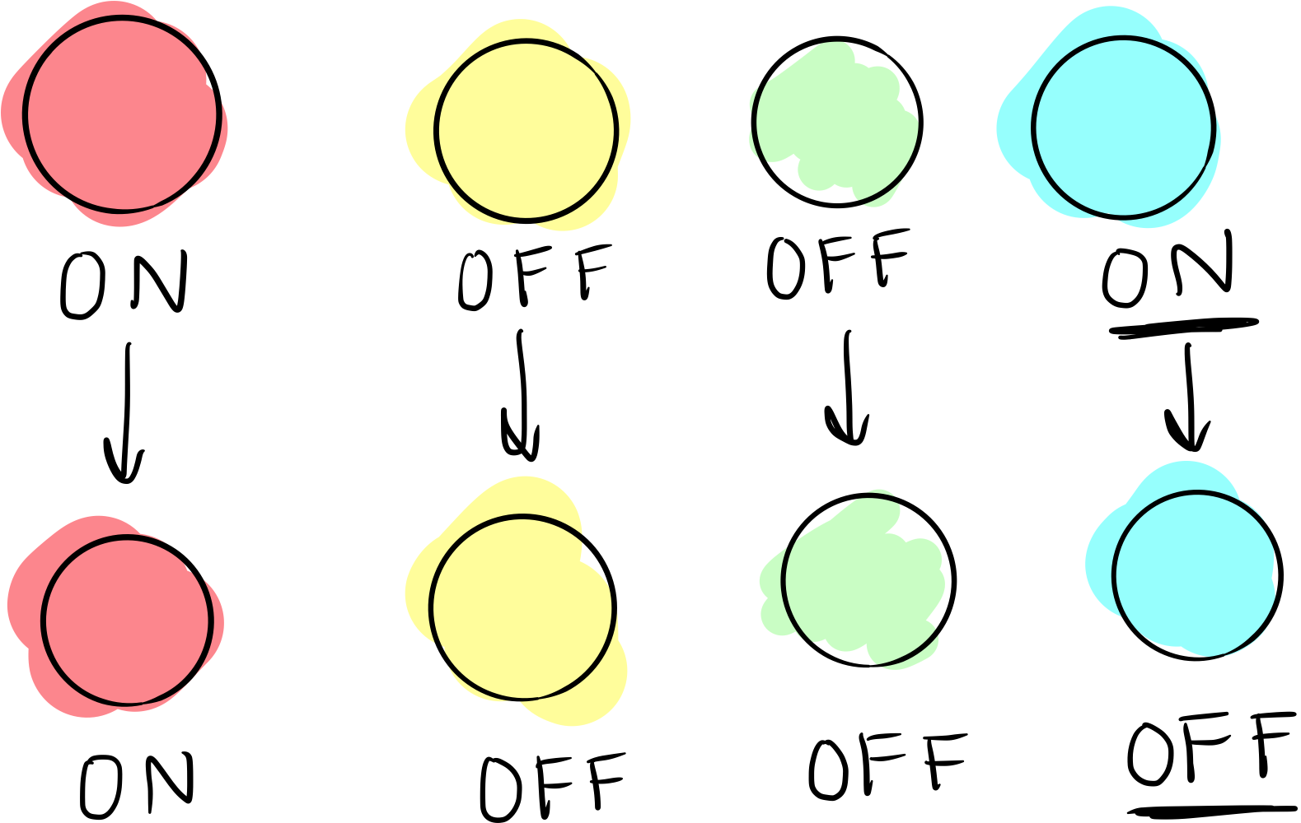
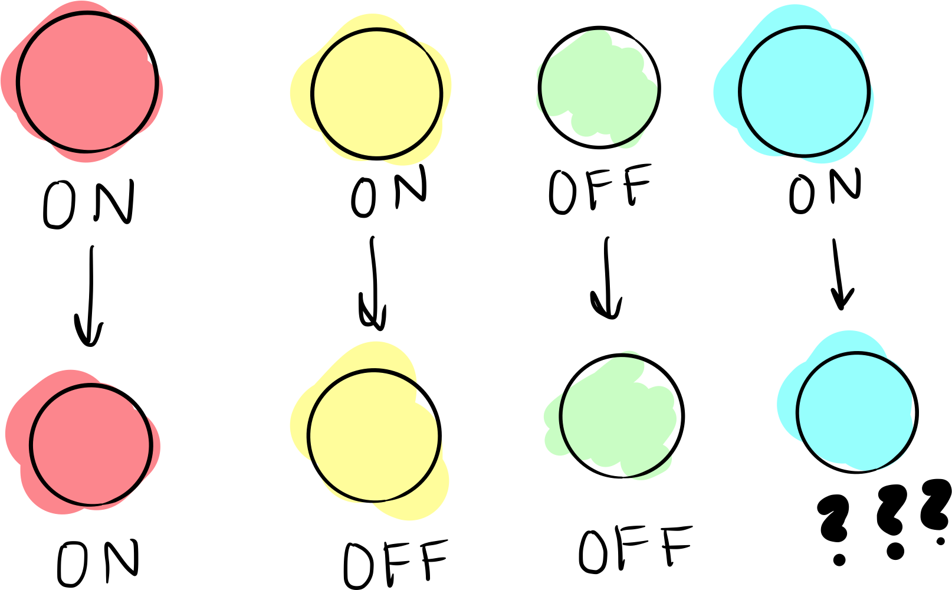
BooleaBayes
BooleaBayes is a rule inference algorithm
We know what affects the expression of a TF in the network (parent nodes)... but how do they affect expression?
First: is effect is inhibitory or activating? In the data the expression of the parent and child will be anti-correlated or correlated respectively
When there are multiple effectors/parents, how do we predict the expression of the child?
Using data, we can infer the rules of interaction between parent and child nodes
Sample at time 0
Sample at time 0
Sample at time 1
Sample at time 1

Slide 19
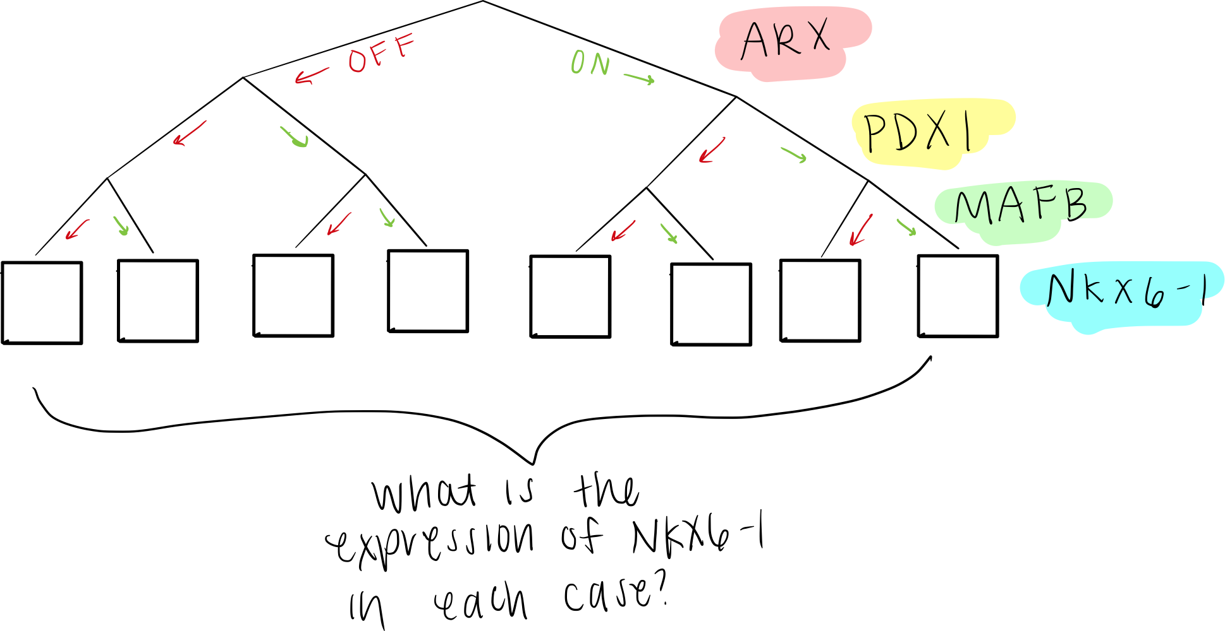
BooleaBayes Rule Fitting for NKX6-1

Slide 20
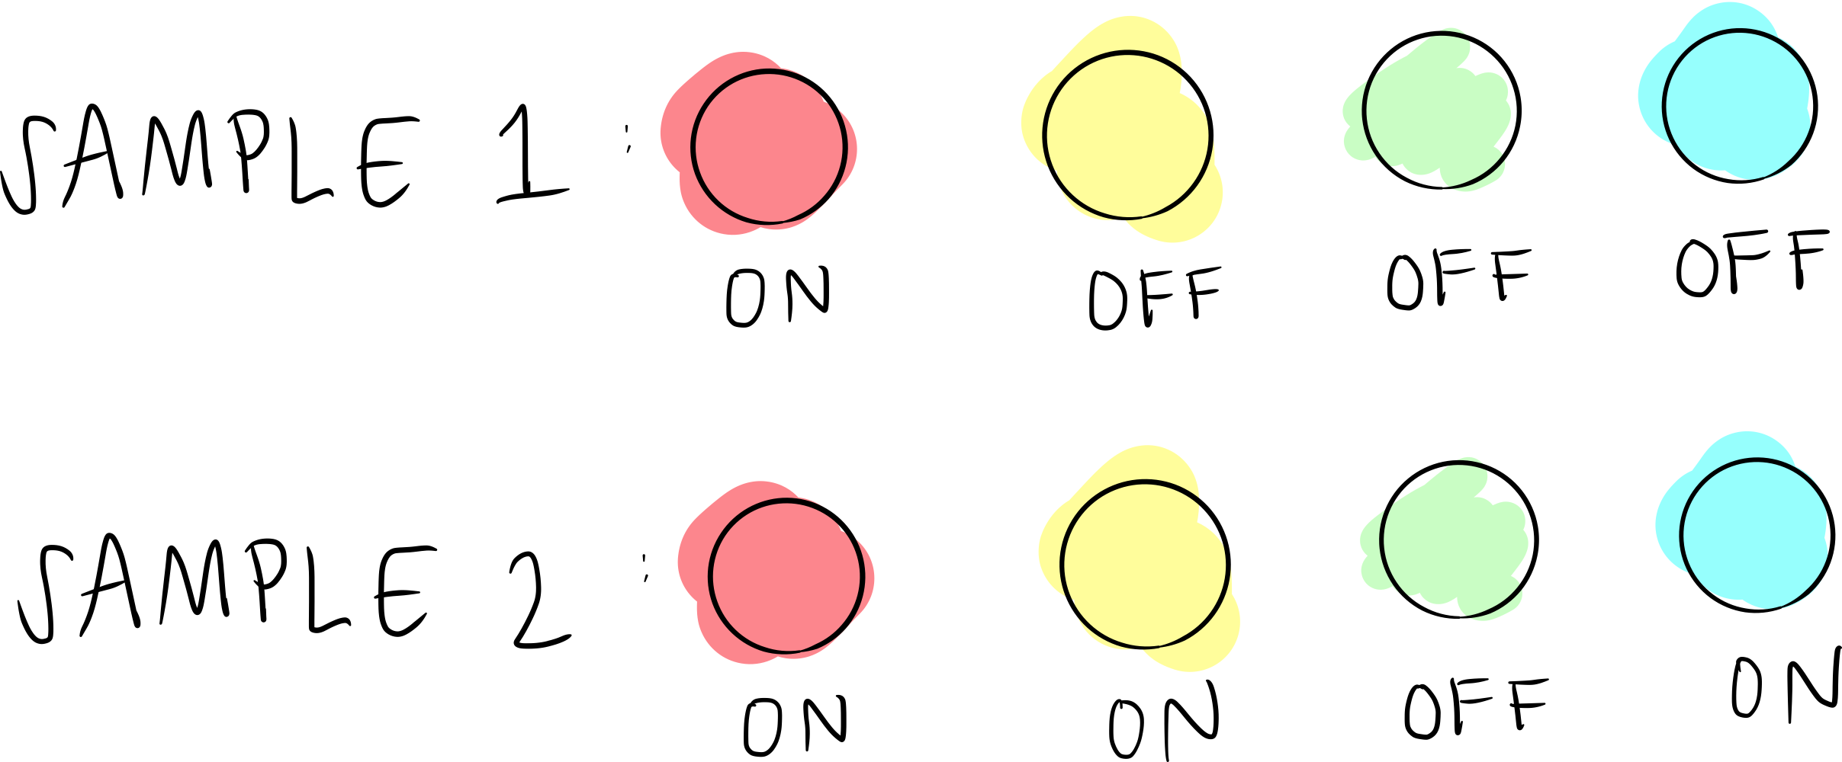


BooleaBayes Rule Fitting for NKX6-1

Slide 21
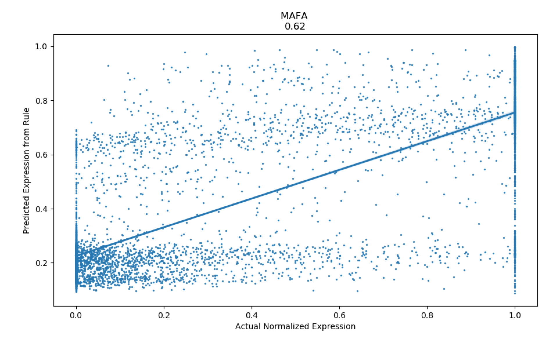
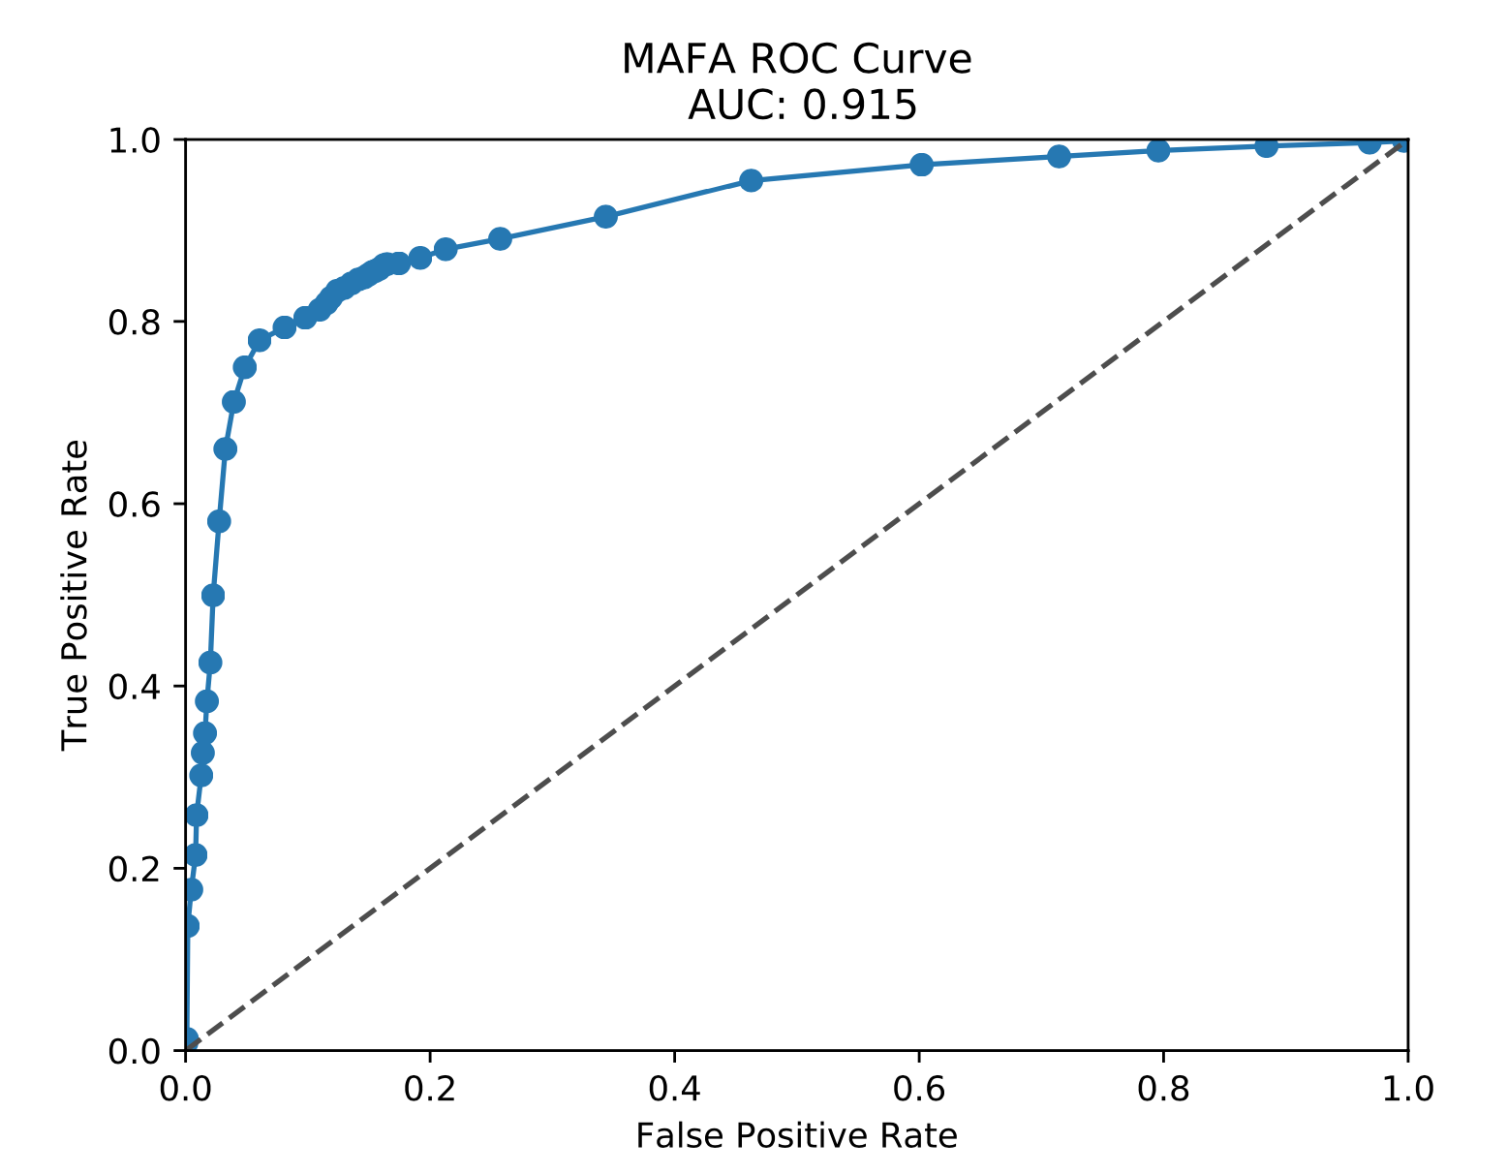
How do we measure success (AUC)
How do we know how good our rules are?
How well can we predict data our model hasn’t seen before?
We split the data set into training and testing sets (first 80/20 split of training set for cross validation)
Compare the output of the rule (the inferred expression level of some TF) to the actual expression from the data
For each rule, make an ROC curve based on the true positive rate and false positive rate
Calculate area under curve (AUC)
Average across TFs for each test to get a measure of goodness of fit

Slide 22
In silico experiment design
Different Network Types:
-Literature derived
-Build network from differentially expressed genes using multiple databases (e.g. ENCODE)
-Build network from genes which vary in pseudotime using the same databases
Different Thresholds:
-How do we binarize the data
-How do we filter out interactions which are not important
Different Data Imputation
-MAGIC vs. SC-IMPUTE
Initially split the data 80/20 for training and testing. So 20% of the cells will never be used to fit the boolean rules
Of the 80% remaining data run 5X cross validation to estimate robustness of fitting results.

Slide 23
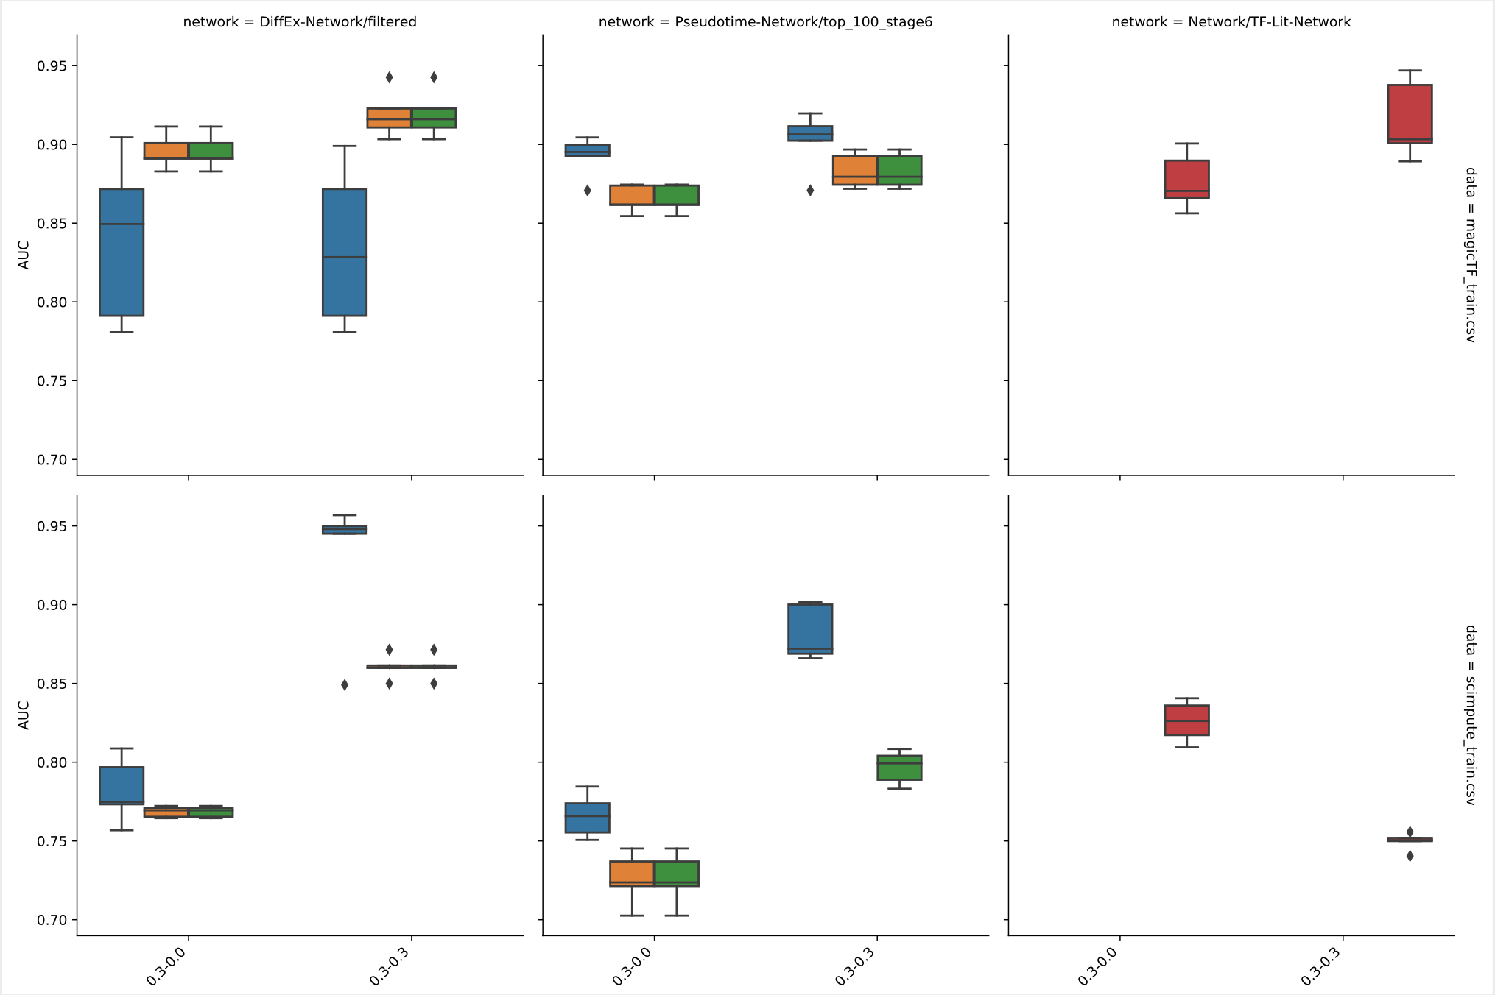
Preliminary Results
Network Type
Differential Expression Pseudotime Literature-derived
Conclusions:
AUC variance between folds is (mostly) low, suggesting method is robust to noisy data
MAGIC-imputed data makes better predictions than SC-IMPUTE
Literature derived network is pretty good at predicting TF expression
No filtering was applied to literature derived network (red)
Variance shown between 5 repeated analyses (cross-fold validation)
0.95
0.90
0.80
0.70
AUC
Improving Average Fit
Data Imputation Method
MAGIC scImpute
0.95
0.90
0.80
0.70
Increased Filtering

Slide 24
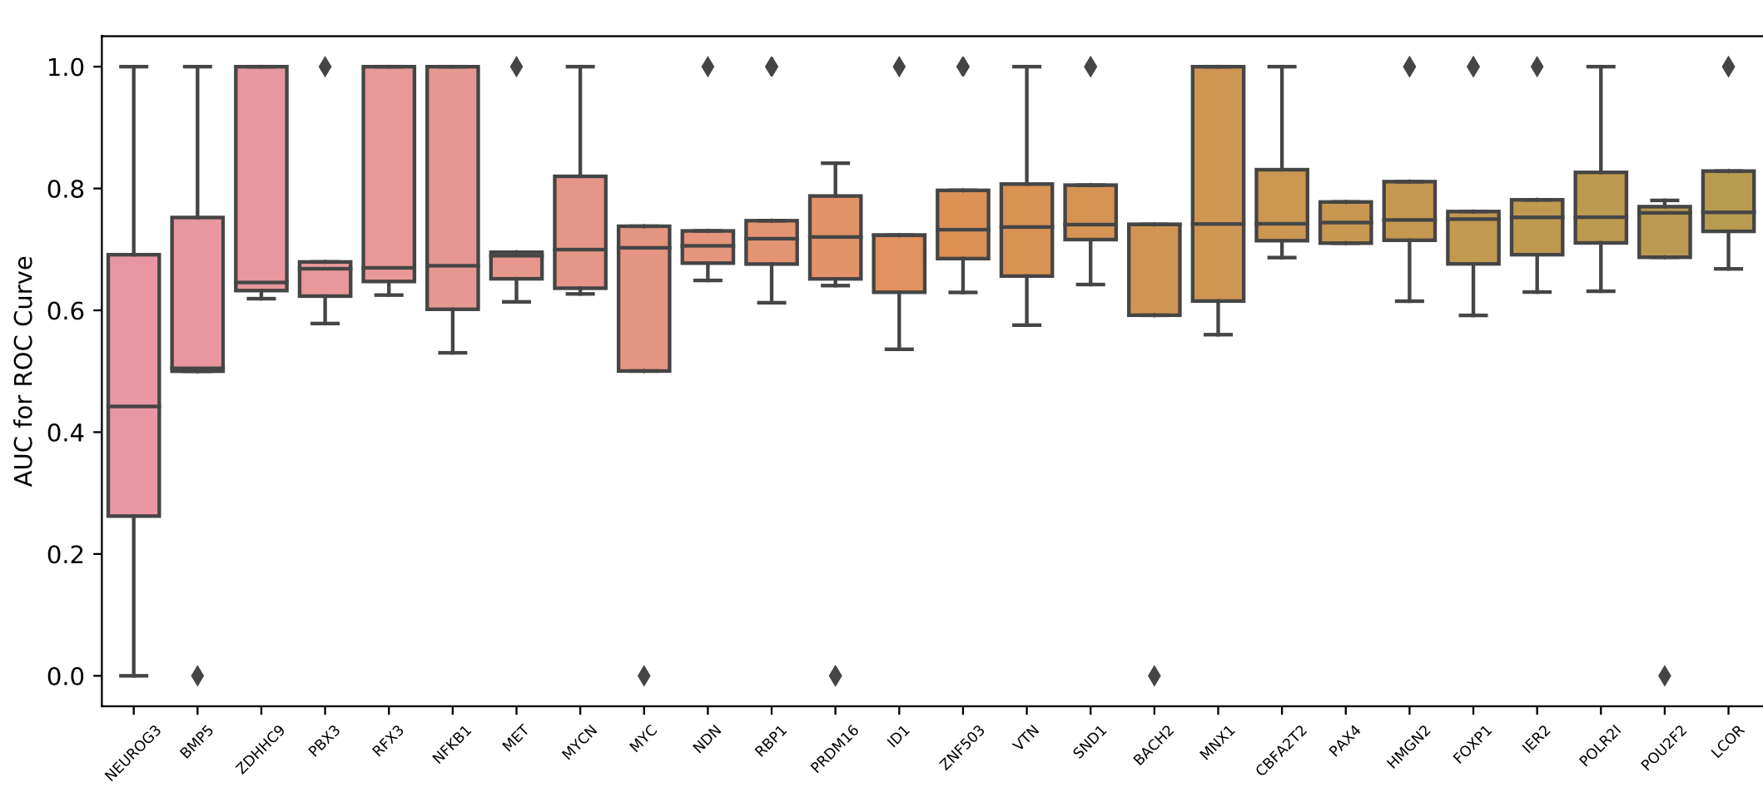
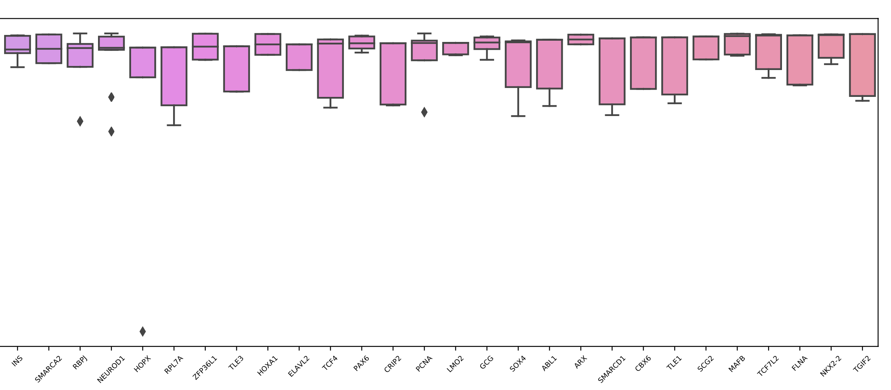
Comparing Genes
Goodness of fit for individual transcription factors vary widely-- some genes are fit more accurately than others

Slide 25
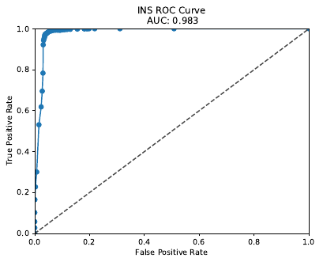
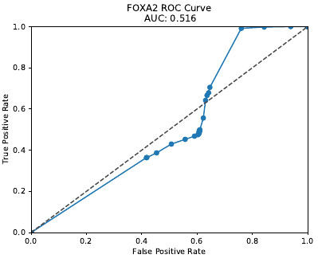
Predictivity on test set (TF-Lit Network)
Once we used AUC values to choose a good network and set of rules, we test it on data the model has never seen before
Accuracy varies between TFs, but most AUC values are significantly above random guessing

Slide 26
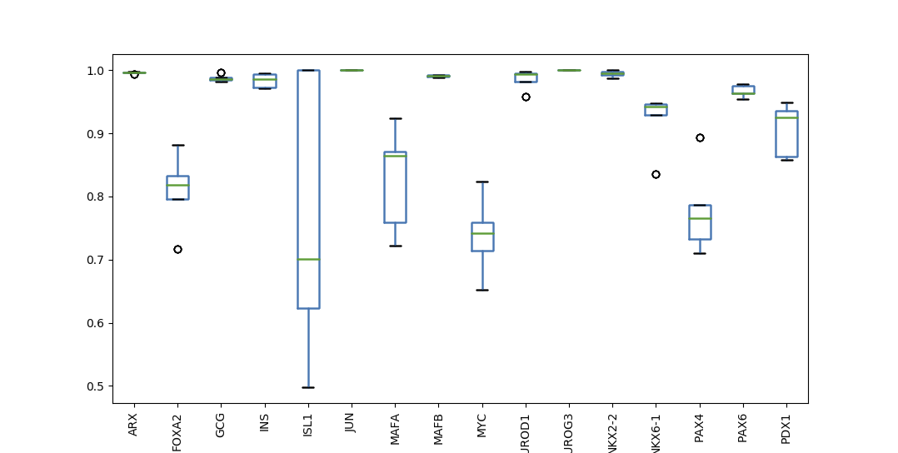
Predictivity on test set (TF-Lit Network)
AUC

Slide 27
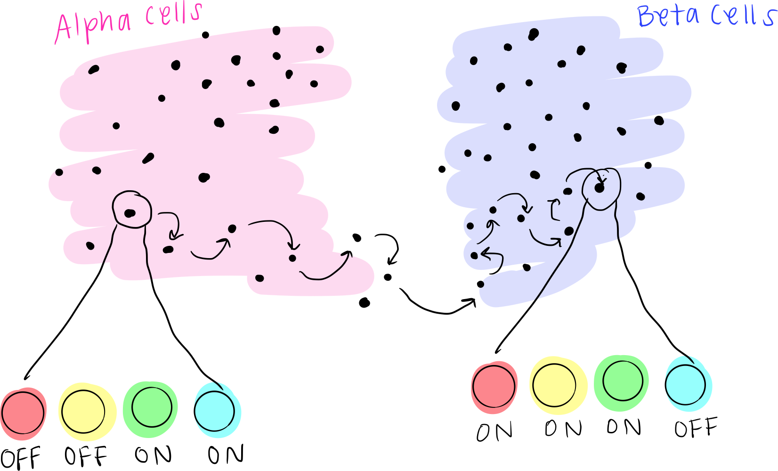
BooleaBayes simulations are made of randomly chosen steps
A simulation consists of randomly “walking” from state to state based on the probabilities defined by the rules
Step 3: Repeat steps 1 and 2 to randomly walk through state space according to BooleaBayes rules
Step 1: Randomly pick TF to update
Step 2: Using that TF’s rule and the current state, update TF and update current state
In this step, you may stay in the same place (i.e. TF expression is not flipped), or move one step

Slide 28
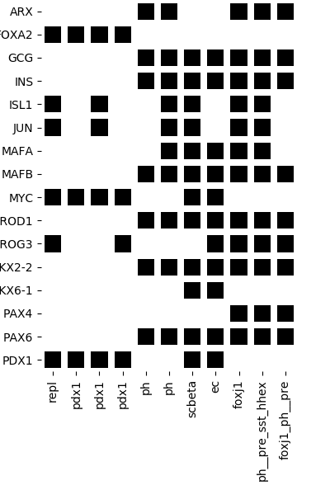
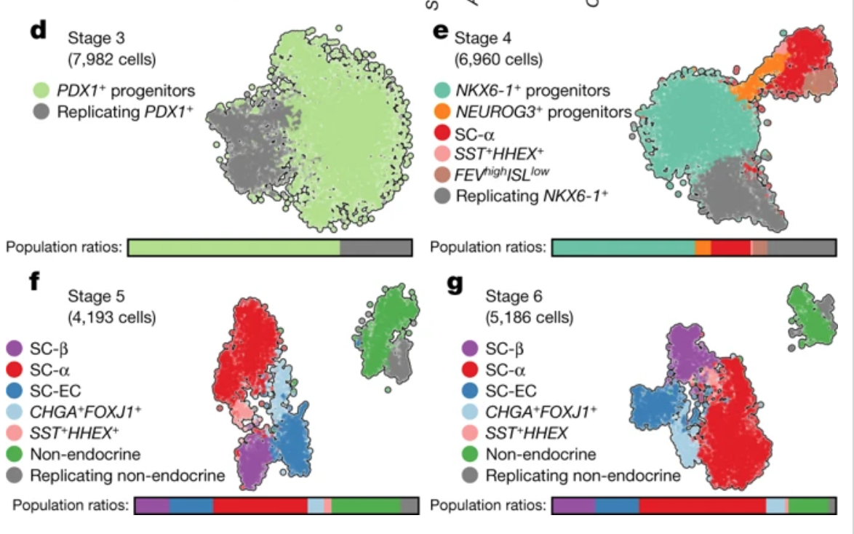
BooleaBayes identifies stable cell states
Attractors are states that we are not very likely to leave once we reach them (they are stable)
F
NEU
NEU
N
N
𝛼
Notes:
Poly hormonal
Poly-hormonal cells that express both insulin and glucagon have previously been reported in several in vitro pancreatic differentiation protocols. Beyond glucagon, these cells express many markers of islet α-cells, but—uncharacteristically for islet α-cells —also express insulin. On this basis, and because the expression of insulin is rectified during stage 6 (Extended Data Fig. 4a), we refer to these cells as SC-α-cells.
Cells that co-express insulin and glucagon have been observed in two contexts: human fetal pancreatic development, in which INS+GCG+ARX+ cells are described as α precursors23, and in type 2 diabetes, in which INS+GCG+ cells are described as de-differentiated β-cells24. Given our evidence that poly-hormonal SC-α-cells are a transient state towards mono-hormonal SC-α-cells, in vitro poly-hormonal cells are more likely to match the developmental INS+GCG+ARX+ cells than de-differentiated β-cells seen in type 2 diabetes.
Some cell states IDed in by clustering have no attactors (transition states)
PAX4 and ARX case study: SC-β- and SC-EC cells are absent at the end of stage 4 and appear during the course of stage 5. Given their shared expression of key genes (such as PAX4 and NKX6-1), we sought to determine whether these cells form separately during endocrine induction or whether one is a precursor for the other.
EC: Our survey identified a population of endocrine cells that express TPH1, NKX6-1 and low levels of insulin, but which lack the β-cell markers G6PC2, NPTX2, ISL1 and PDX1.
NEUROG3: NEUROG3, a transiently expressed master regulator of in vivo endocrine induction, is expressed by cells that bridge endocrine and non-endocrine cells within this continuum, as different cell types gradually emerge
Our analysis suggests that SC-β and SC-EC cells emerge from a common NEUROG3+ induction intermediate, rather than one serving as a progenitor for the other. Thus, this constitutes a second fate bifurcation on the trajectory of SC-β-cell formation
δ-like cells that show co-expression of SST and HHEX.

Slide 29
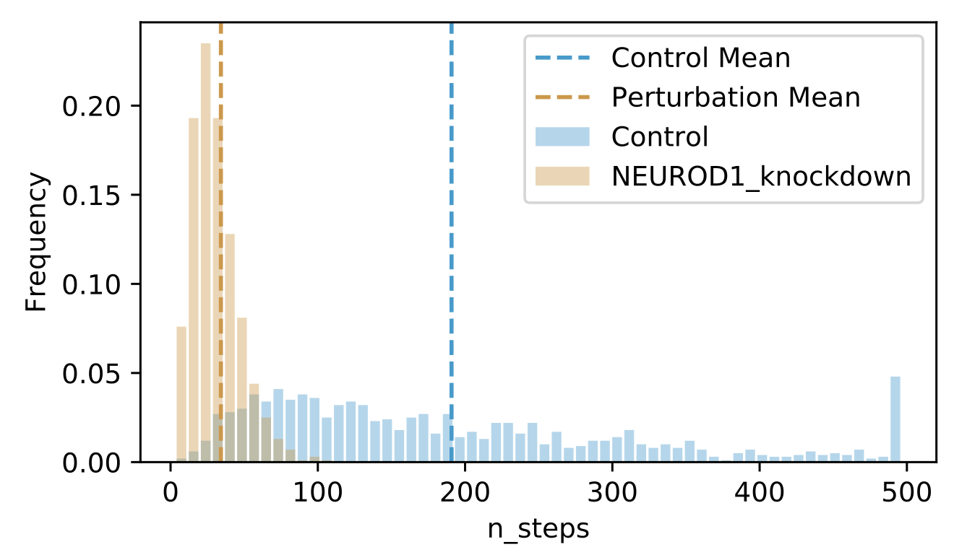
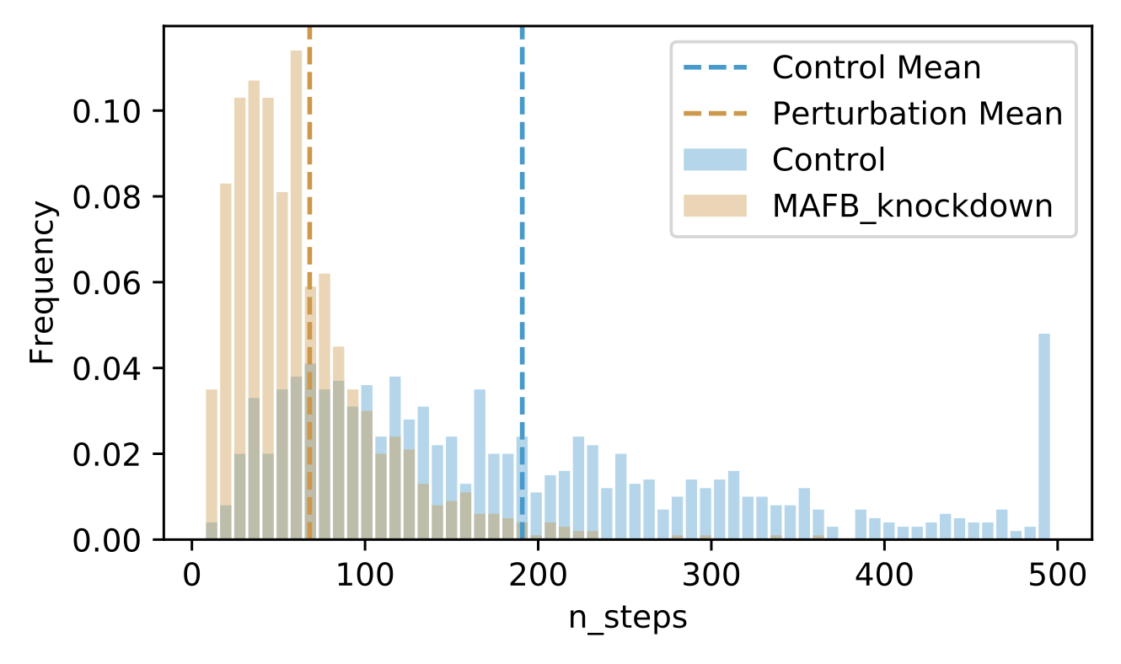
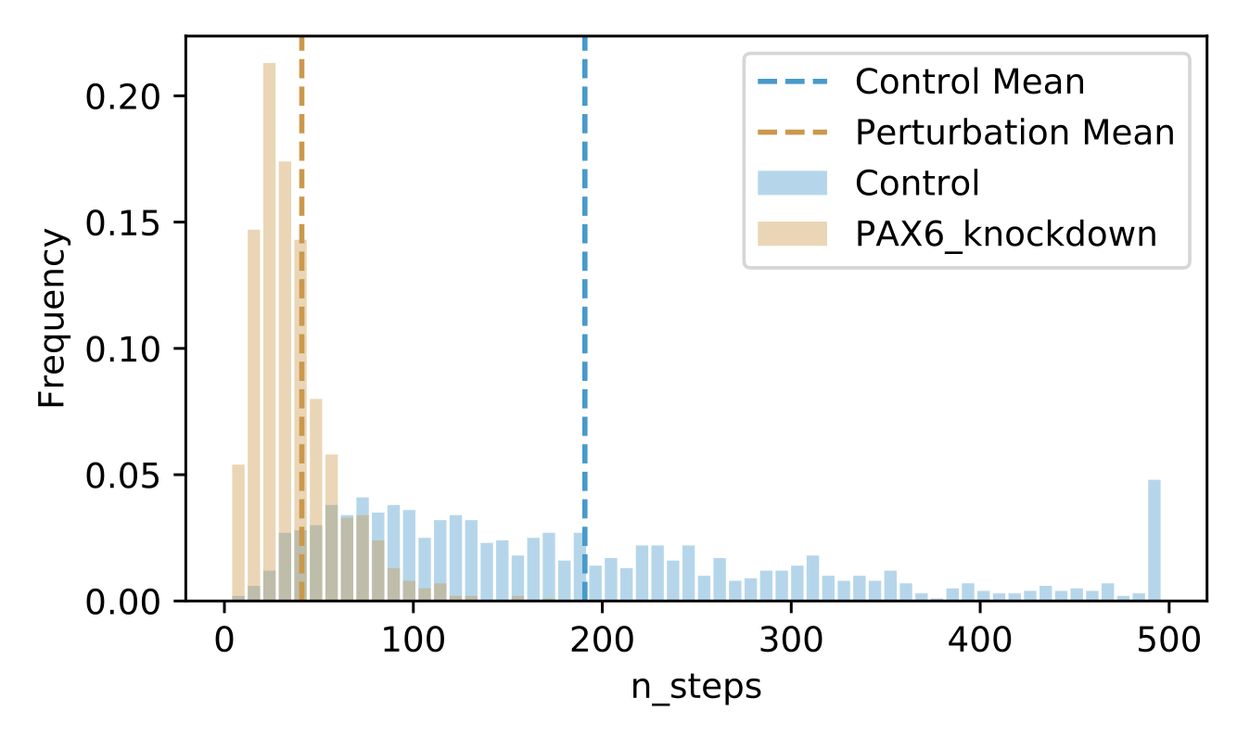
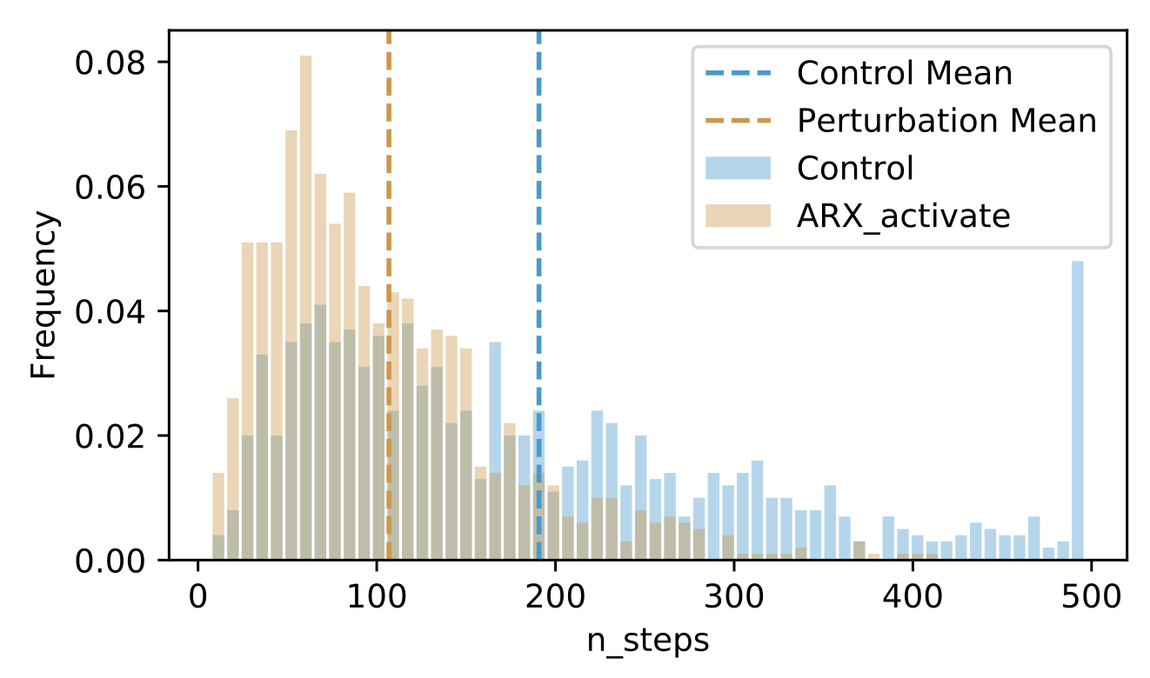
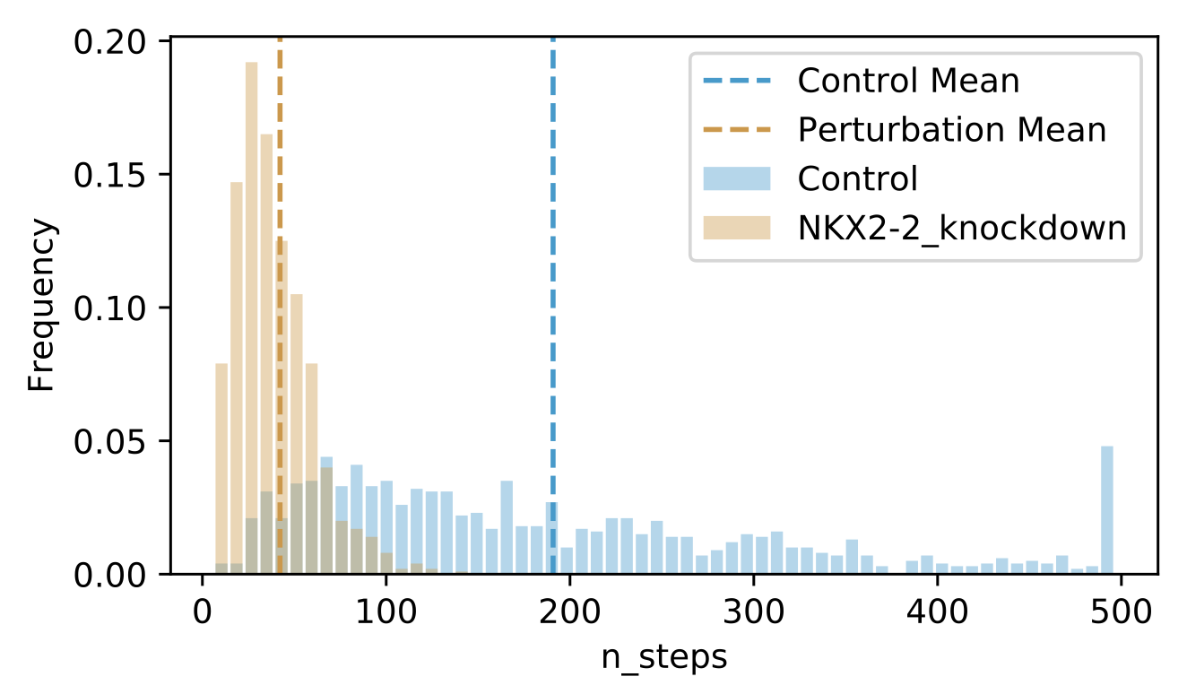
In silico perturbations identify destabilizers of SC-β cells
Number of steps to leave attractor is a proxy for stability
Shift of mean to the left = takes fewer steps to leave attractor due to perturbation = destabilizing perturbation
Notes:
NKX2-2 Transcriptional activator involved in the development of insulin-producing beta cells in the endocrine pancreas
In the pancreas, Aristaless-related homeobox gene (Arx) is expressed first in the endocrine progenitors and then restricted to glucagon-producing α-cells. While the functional requirement of Arx in early α-cell specification has been investigated, its role in maintaining α-cell identity has yet to be explored.
NEUROD1 was initially identified as a transactivator of the insulin gene (5), and subsequent studies demonstrated that NEUROD1 has a broader role in regulating β-cell function through the direct activation of genes important for β-cell maturation and function
The pancreatic-islet-enriched transcription factors MafA and MafB have unique expression patterns in β cells in rodents. MafA is specifically expressed in β cells and is a key regulatory factor for maintaining adult β-cell function, whereas MafB plays an essential role in β-cell development during embryogenesis, and its expression in β cells gradually decreases and is restricted to α cells after birth in rodents. However, it was previously observed that MafB started to be reexpressed in insulin-positive (insulin+) β cells in MafA-deficient adult mice.
The transcription factor Pax6 is required for pancreatic β cell identity, glucose-regulated ATP synthesis, and Ca²⁺ dynamics in adult mice

Slide 30
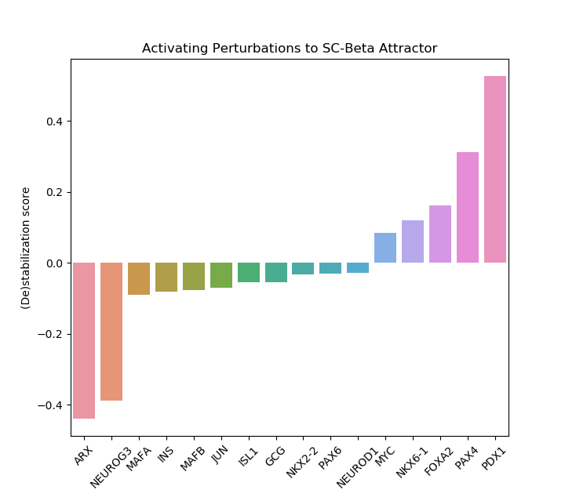
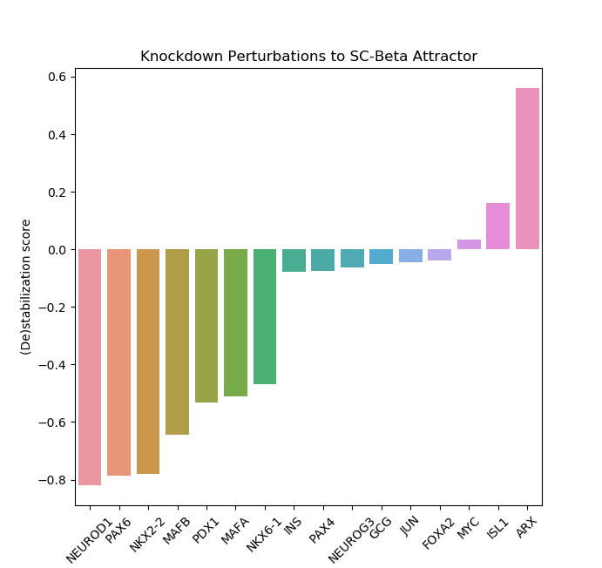
In silico perturbations identify (de)stabilizers of SC-β cells
Most destabilizing perturbations to SC -β cells include NEUROD1*, PAX6, or NKX2-2* knockout
Most stabilizing perturbations to SC-β cells include PDX1* or PAX4* activation and ARX* knockout
*supported in Spencer Willet and Chris Wright (2011) Pancreatic Plasticity and Reprogramming: Novel Directions Towards Disease Therapy.

Slide 31
Mouse mutants of NeuroD1 have arrested endocrine cell development during the secondary transition, with reduction in all endocrine cell types. The remaining endocrine cells fail to form islets (Naya et al. 1997). … For example, a recent report on insulin-cell-specific deficiencies in NeuroD1 suggests that it is essential for the proper activation of both insulin genes in mice (Gu et al. 2010).
Nkx2.2 mutants highlight the extreme lineage switching caused by single factor removal. Total endocrine cell number is almost normal but b cells are replaced by large numbers of the normally minor ghrelin producing e cell.
Two separate subsequent studies moved on to test the sufficiency of Pax4 and Arx as inducers of their respective cell fates in general endocrine-committed progenitors or lineage-committed endocrine precursors. Arx mis-expression in embryonic endocrine cells, using a transgenic Pax6 promoter activation approach, caused the loss of b/d-cell characteristics and increased a- and PP-cells. Insulin promoter-based Arx mis-expression in embryonic or adult b-cells also converts b-cells to a- or PP-cells (Collombat et al. 2007). Mis-expression of Pax4 in pancreatic or endocrine progenitors caused increased numbers of cells to adopt the b-cell identity, reducing flux to the a, d, or PP fate, and glucagon promoter mis-expression of Pax4 in a-cells diverted them to b-cells (Collombat et al. 2009). From a therapeutic reprogramming perspective, finding ways to engage specifically, controllably, and perhaps only in a fraction of them, the expression of “b-cell trigger factors” such as Pax4, or of inhibiting Arx in mature a-cells, could be enough to reprogram enough cells into b-cells to ameliorate the effects of diabetes. Our own studies indicate that other factors, such as Pdx1 (which is expressed at the highest levels in the b-cell lineage), show a stage-dependent ability to effect an a- to b-transformation (Yang and Wright, unpublished data)
*I know this book chapter is old (2011), but it most comprehensively agreed with our predictions

Slide 32
Immediate next steps
Compare results to random permutations of networks
This will be a “negative control” to compare our accuracy scores to, rather than “better than random (0.5)”
Select 3 best models and using ensembles find core motifs most important for predictions
Find regulators of bifurcation junctures
Predict perturbations to reprogram alpha cells into beta cells efficiently

Slide 33
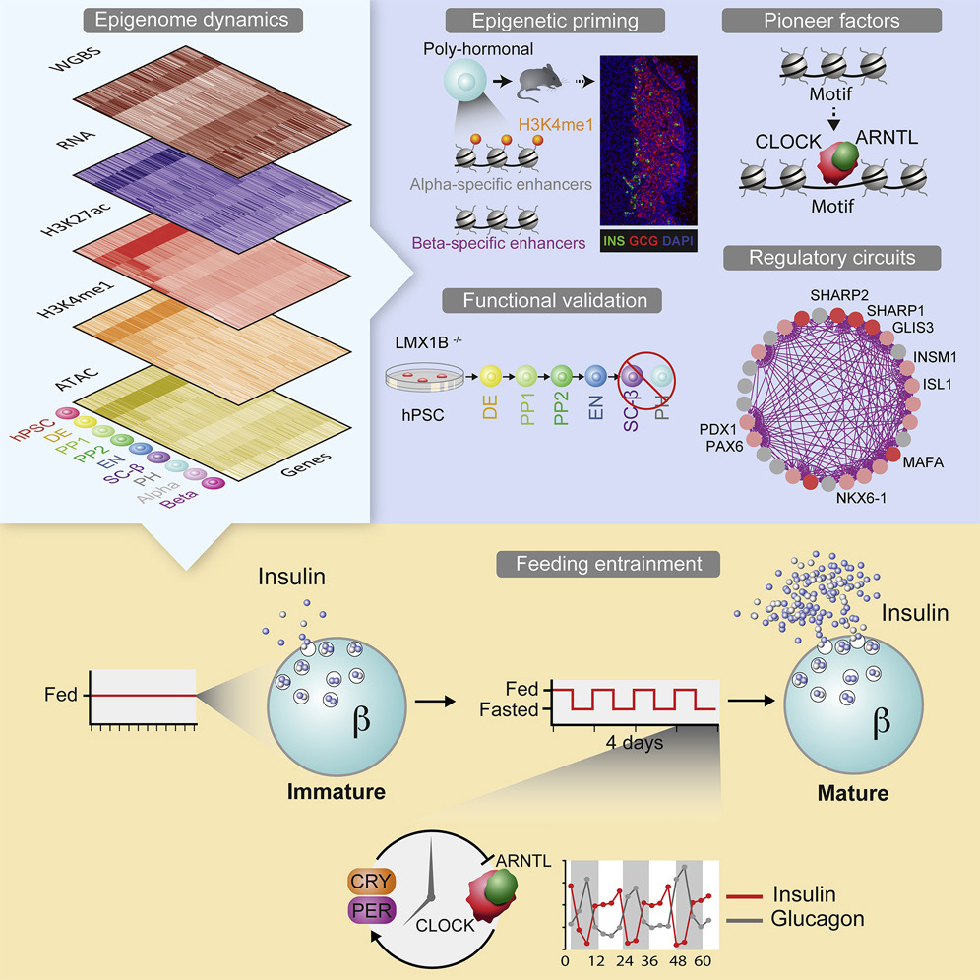
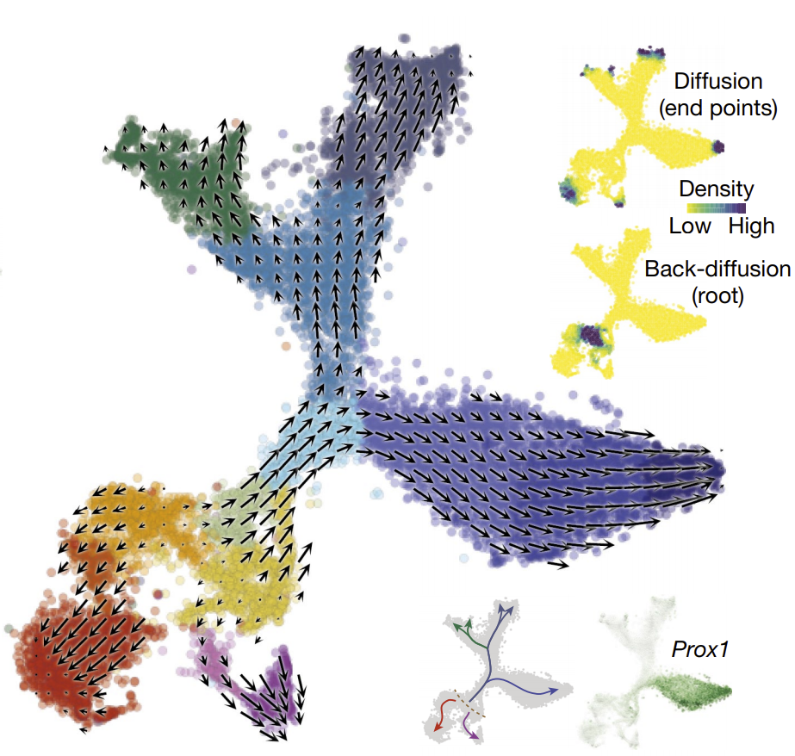
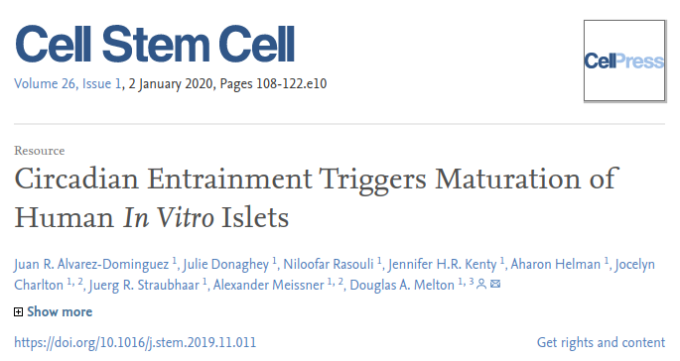
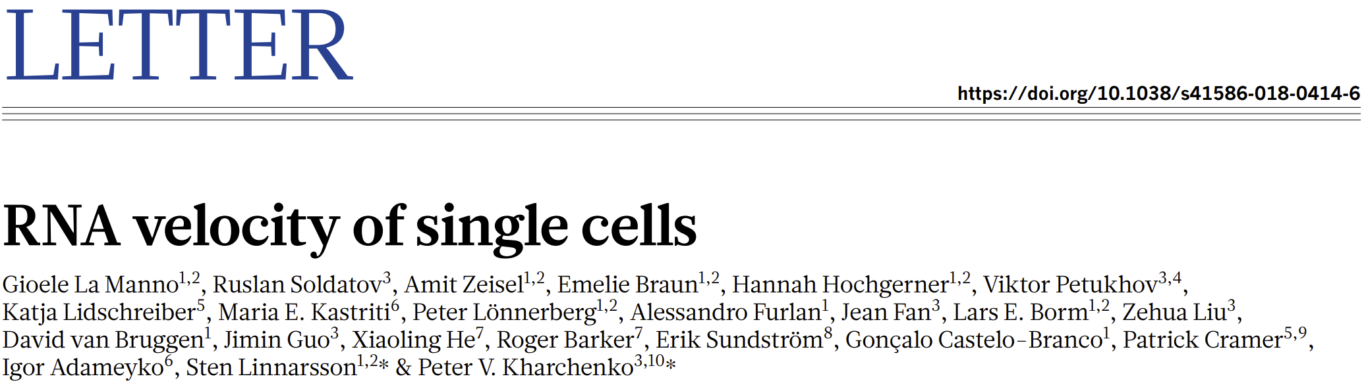
Long term goals
Incorporate RNA velocity
Incorporate ATACseq information
Test manipulation strategies
Identify Pioneer Factors from Simulations

Slide 34
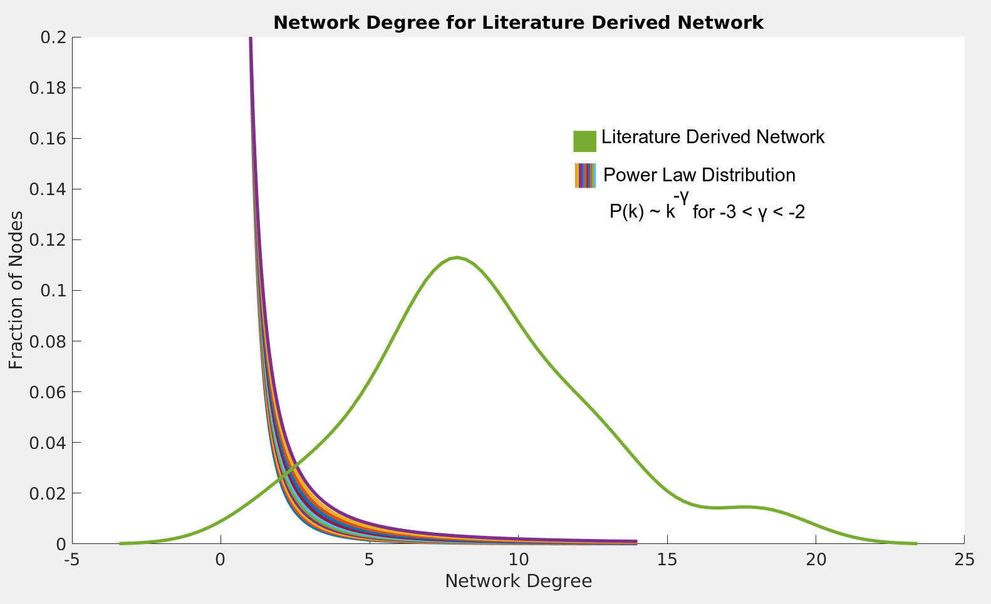
The TF-lit network is highly connected compared to most biological networks

